Slide 1
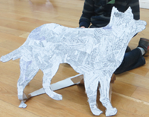
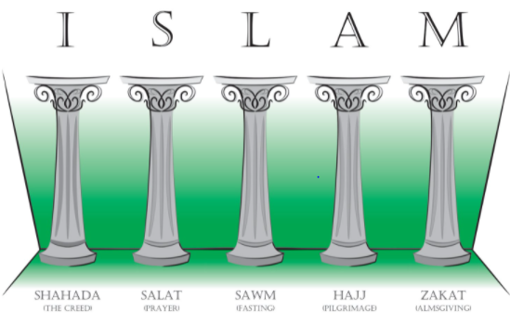
Year Five Curriculum Overview Autumn Term 2021
Reading opportunities: Shackleton’s Journey, The Polar Bear Explorers Club
History/Geography
Tracking Shackleton
Religious Education
What does it mean to be a Muslim in Britain today?
Science
Earth and Space
Computing
Sharing information
Art
Flat, yet sculptural
Intent
To find out about the achievements of Shackleton and to use geographical map skills to develop knowledge of the wider world and navigation.
Intent
To explore what people of the Muslim faith believe and what difference this makes to how they live.
Intent
To learn about the planets in the solar system and describe the relative movements of the Earth, Sun and Moon.
Intent
Develop understanding of how information is transferred between a variety of different real-world systems and devices.
Intent
Children will develop their drawings through collage and construction to transform them into sculptures.
Sequence of lessons
To find Antarctica's place on the Earth and on a map. To understand the size and composition of Antarctica.
To know some of the locational features of Antarctica. To explain longitude and latitude.
To understand hot and cold climate zones and the influence of the earth’s orbit.
To understand Antarctica's mountainous terrain, oceans and their effects upon the expedition. To understand the route taken by the Endurance Expedition.
To use mapping skills combined with grid references.
To comment in the contrasting localities of Shackleton’s Expedition.
Sequence of lessons
Who are the Muslims in your region?
What helps Muslims through the journey of life?
Why is Zakah/charity important to Muslims? How is charity important to you?
Why do Muslims go on a pilgrimage?
Where do Muslims get guidance for living?
What does it mean to be a Muslim in Britain today?
Sequence of lessons
Suggest how scientific evidence could be used to support ideas. Explore how scientists answer questions and collect current knowledge and questions about space.
Describe the movement of the Earth, and other planets, relative to the Sun in the solar system.
Make a model of the solar system.
Investigate shadows using the idea of the Earth’s rotation to explain the apparent movement of the sun across the sky.
Explore the Earth’s movements using sundials and time zones.
The Moon.
Sequence of lessons
To explain that computers can be connected together to form systems.
To recognise the role of computer systems in our lives.
To recognise how information is transferred over the internet.
To explain how sharing information online lets people in different places work together.
To contribute to a shared project online.
To evaluate different ways of working together online.
Sequence of lessons
To develop drawing skills.
To explore negative space and mark making.
To explore scaling up and collage.
To explore sculpture and structure.
Composite outcome
Create a visual timeline for display of the events of the Expedition along with detailed geographical information.
Composite outcome
Children will produce a script of a conversation detailing the answer to the key question.
Composite outcome
To produce a class TV program – Stargazing.
Composite outcome
To take part in a collaborative online project with other class members.
Composite outcome
To create a sculpture of an Antarctic animal.
Impact
Children have a secure locational understanding of Antarctica and it’s place within the earth.
Impact
Children will be able to explain the importance of the 5 pillars to British Muslims today.
Impact
Children will link movements of the Earth, Sun and Moon to familiar timescales such as day and night.
Impact
Children will develop their understanding of computer systems and their skills in working together online.
Impact
Children will increase their confidence and ability in drawing, collage and construction.

Slide 2
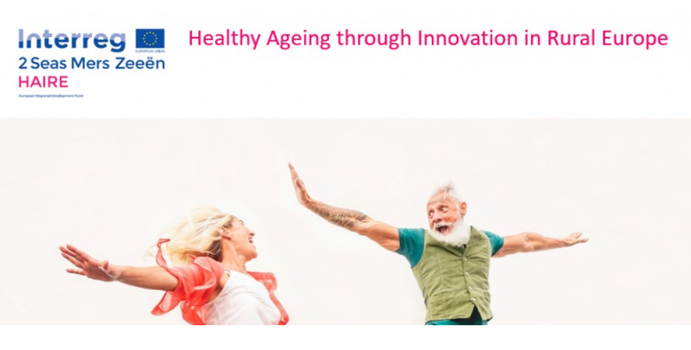
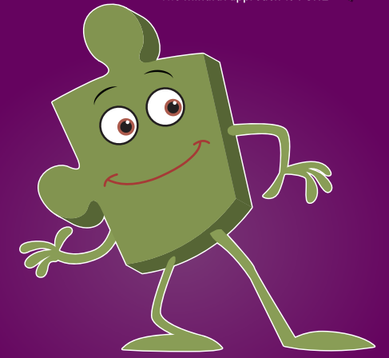
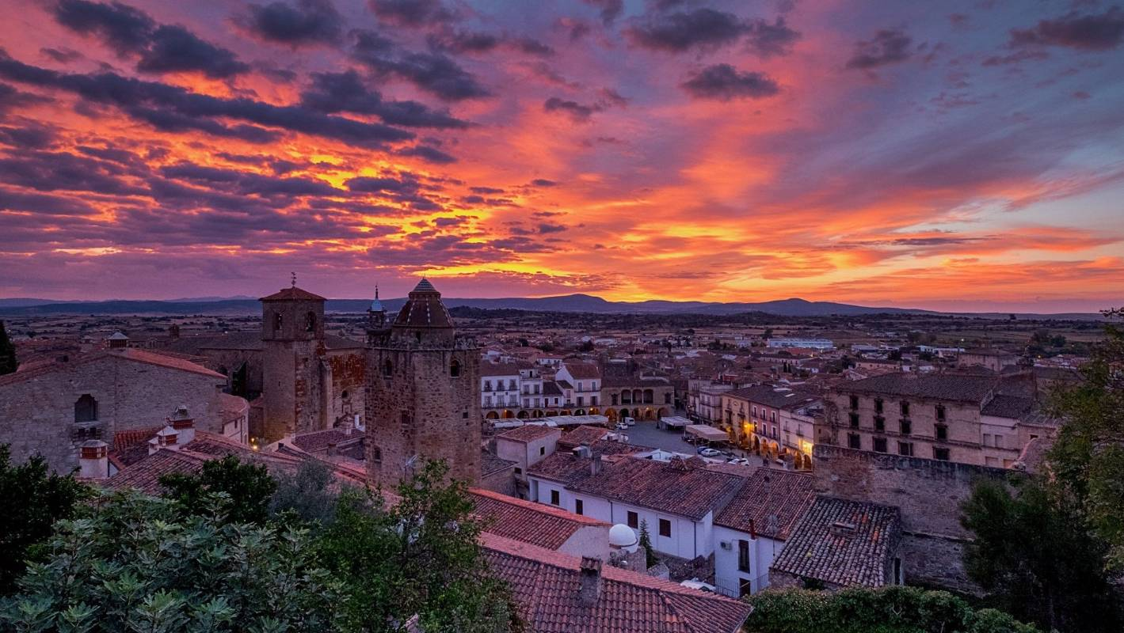
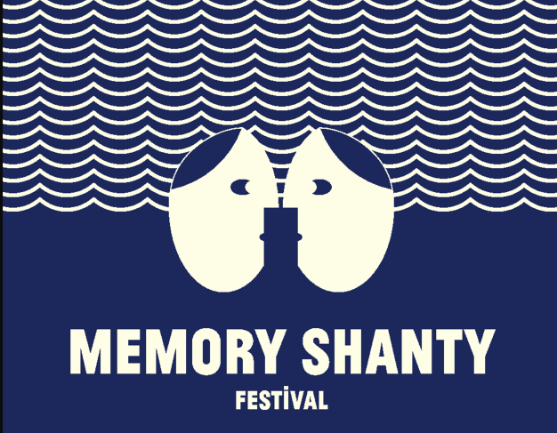
Year Five Curriculum Overview Autumn Term 1 2021
Memory Shanty Community Project
Year 5 have been invited to take part in an exciting project involving members of our community.
The Memory Shanty Festival will be the first in the world to combine sound art, wellbeing and intergenerational intervention as a public performance experience which will celebrate and value our elders. It will strengthen community resilience through shared experience, creative care and hope.
Spanish
My Town
PSHE
Being Me in My World
Music
Livin’ on a Prayer
Intent
Children will learn to describe places in a town, count to 100 and give their address in Spanish.
Intent
Children will learn about their rights as a child, their responsibilities in Year 5 and why we have rules. They will also compare their lives with the lives of other people in our country.
Intent
Children will listen and appraise a variety of rock songs, learning about their structure. We will be learning to play and compose using the notes A,G and B.
Sequence of lessons
To ask and answer the question: “Where do you live?”
To describe what there is in a town.
To identify tens up to 100.
To recognise and say numbers 0-100
To say and ask where we live.
To use a bilingual dictionary to develop vocabulary.
Sequence of lessons
My year ahead
Being a citizen of my country
Year 5 responsibilities
Rewards and consequences
Our learning charter
Owning our learning charter
Sequence of lessons
To listen and appraise ‘Livin’ on a Prayer’. Start to learn the song.
To listen and appraise ,’We will Rock You’. To sing the song and play instrumental parts.
To listen to and appraise,’ Smoke on the Water’. To play instrumental parts and improvise.
To listen to and appraise,’Rockin’ All Over the World’. To play musical parts, improvise and compose.
To listen to to and appraise, ’Johnny B. Goode’. To play instrumental parts, improvise and use own composition.
Composite outcome
Converse with each other in class in Spanish about where they live.
Composite outcome
To contribute to, and take ownership of, a whole-school learning charter.
Composite outcome
Perform the song ‘Livin on a Prayer’ with own compositions in an assembly.
Impact
Children develop their range of Spanish vocabulary and their intercultural understanding.
Impact
Children understand their rights and responsibilities and how these lead on to a consistent positive behaviour system at school.
Impact
Children are confident in how pulse, rhythm, pitch, tempo, dynamics, texture and structure work together and how they connect in a song.

