Slide 1
Chinese School Group Visit Homestay information evening Planned dates: Sunday 28th January– Saturday 3rd February 2018 Devoran Primary School

Slide 2
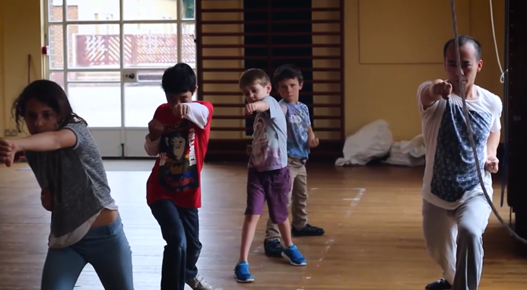
Benefits of visit
Learn about other cultures
Spark an interest in learning other languages
Find out more about the world
Encourage tolerance and understanding of people with different experiences

Slide 6
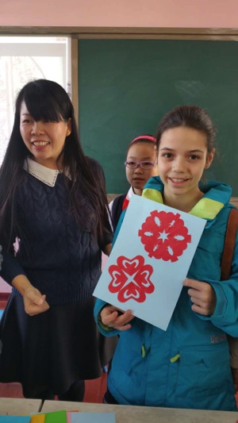
Why host students?
Invite a new culture in to your home to share with your family
China is an important country – it will be useful for your children to know more about its customs and culture
Spark an interest in learning Mandarin
Make friends in China that they can keep in touch with
Plus, your children will learn a lot about being a good host

Slide 7
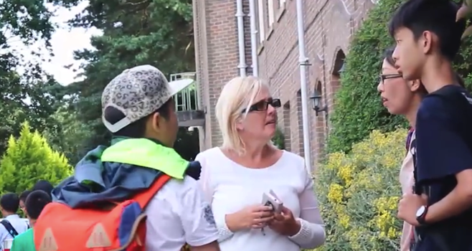
Schedule
The students will arrive at Devoran School on Sunday 28th January
They will stay with their host family until Saturday 3rd February (6 nights)
You would take them to school each morning with your own children and pick them up at the normal time.
On the Saturday the Chinese students will be picked up from Devoran Primary School

Slide 8
Hosting
For safeguarding purposes, we are required to place two visiting students in each home
You would be required to provide breakfast and dinner for the students, plus a packed lunch each day
The students will be aged between 8 and 11
We will facilitate any specific requirements (e.g. dietary or allergies)
You will receive £180 for hosting 2 students

Slide 9
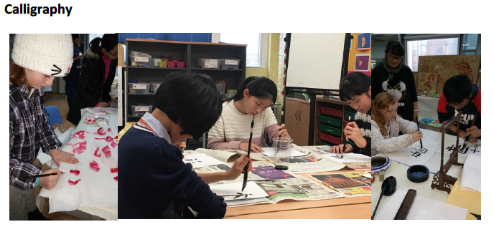
Chinese immersion
Chinese Culture Lessons are provided at the school during the programme

Slide 10
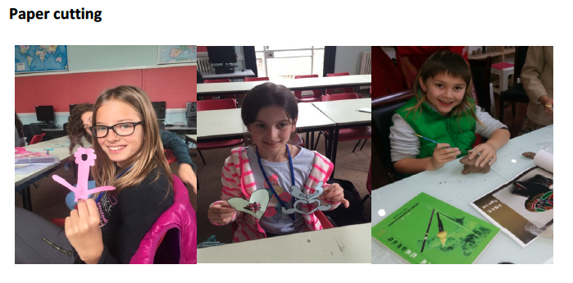
Chinese immersion

Slide 11
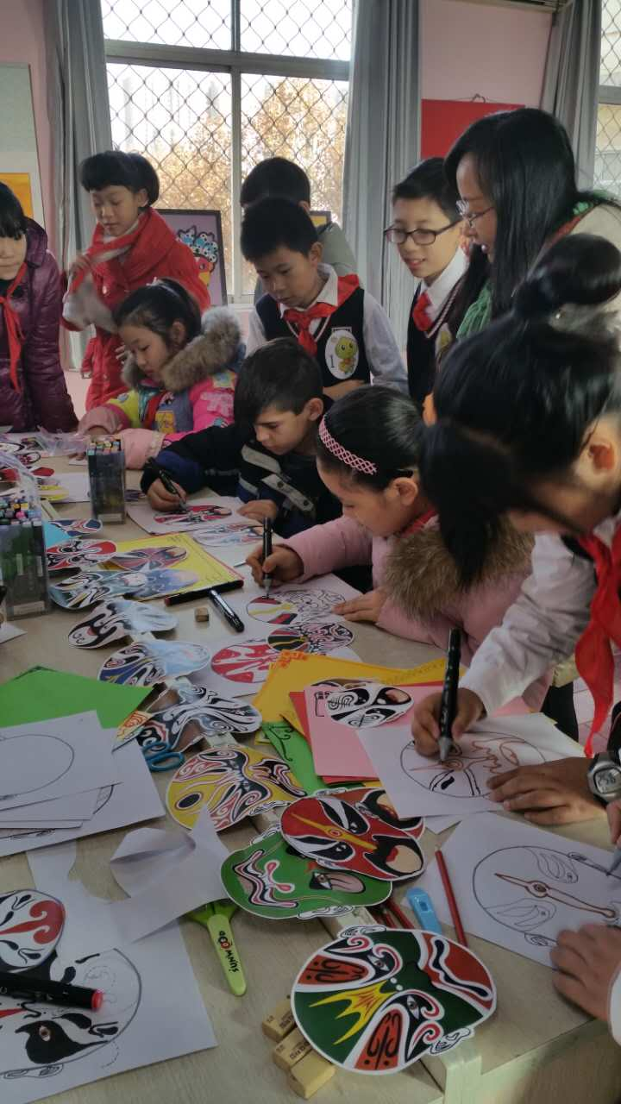
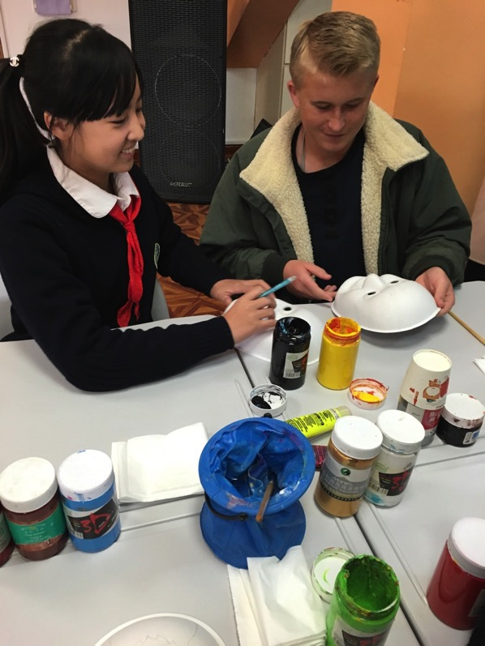
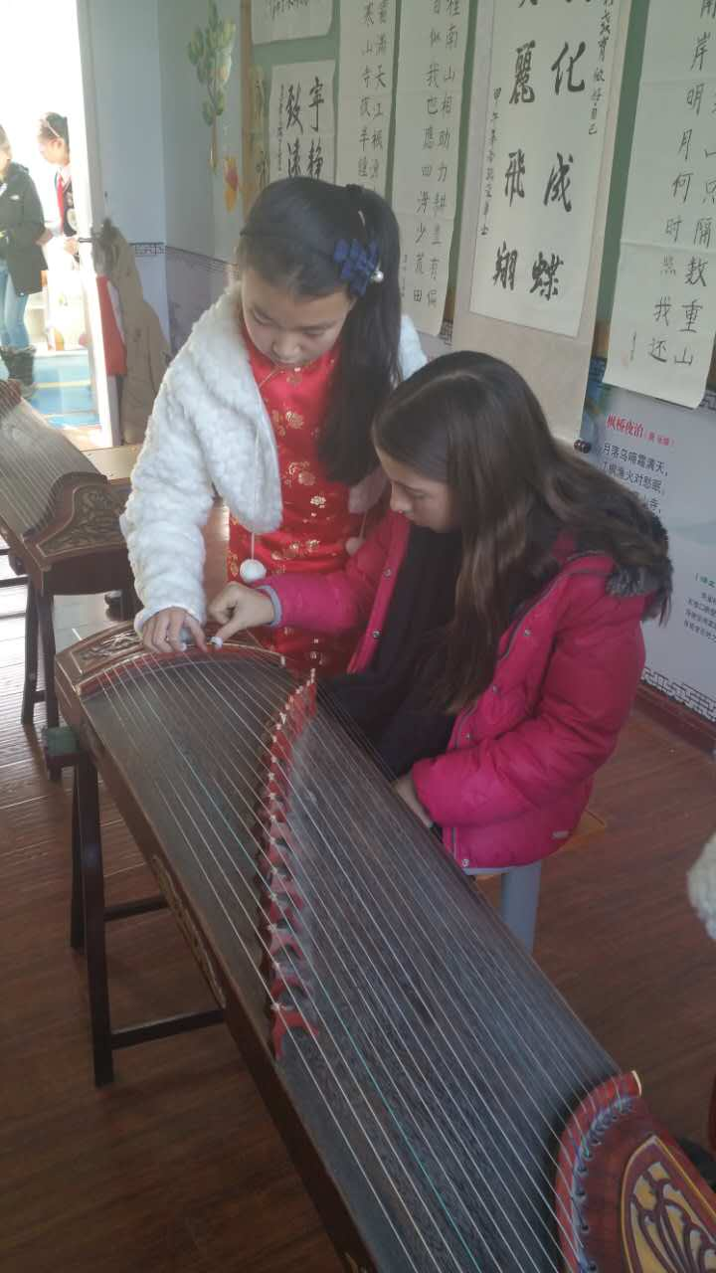
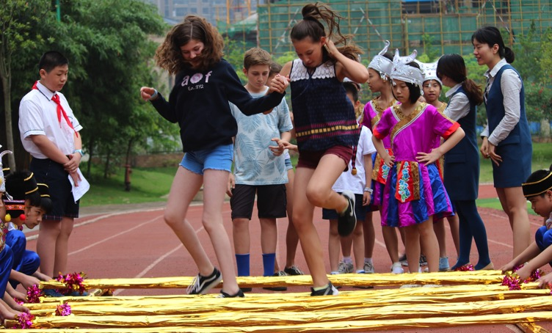
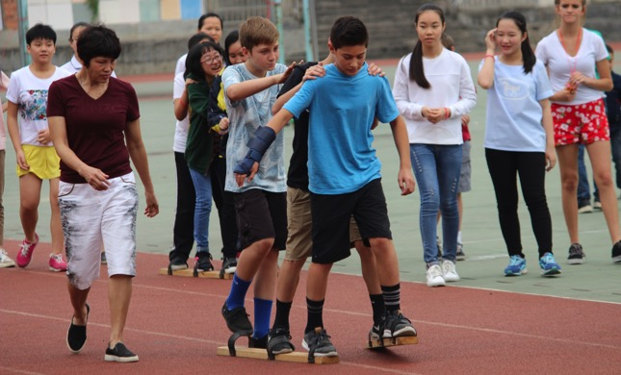

Slide 12
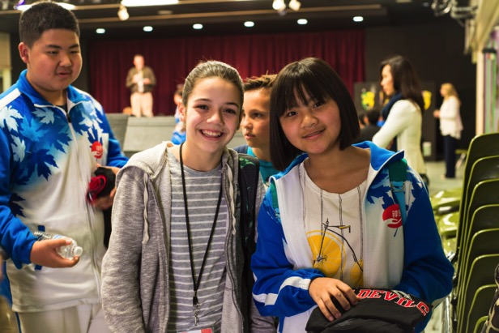
What happens next?
Confirm your interest by Wednesday 8th November
A member of our team will visit your home (to view room that student will be staying and answer any questions)
We will conduct a DBS check (legal requirement)
Receive homestay advice and guidance pack
Our team are on hand 24/7 for any issues or emergencies
Enjoy the cultural exchange

Slide 13
Frequently asked questions
I only have space for one student – can I still host?
What do the students like to eat?
I have pets – is that a problem?
Any others?

Slide 14
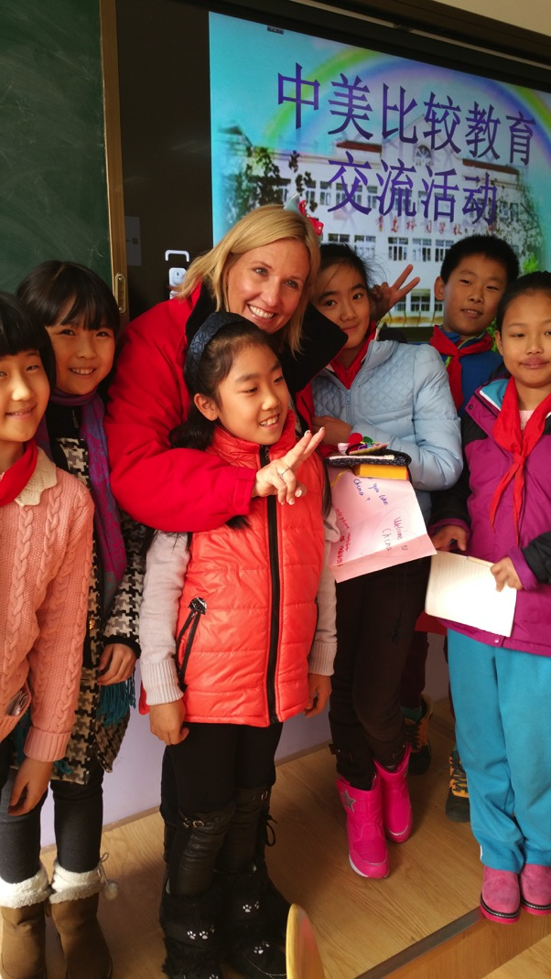

Slide 15
Chinese School Group Visit Homestay information evening homestay@opportunity-education.com

