Slide 1
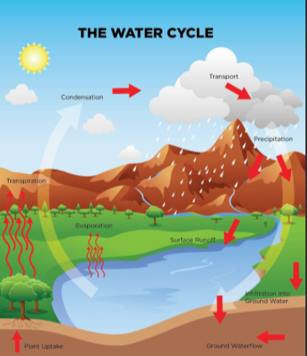
Year Six Curriculum Overview Autumn Term 2021
Reading opportunities: Kensuke’s Kingdom, The River Story
History / Geography
Religious Education
Science
Computing
Intent
Learning about the water cycle, rivers and the effect they have on the landscape. Learning how rivers develop from the source to entering the sea.
Intent
Explore what people believe and what difference this makes to how they live, gaining the knowledge, understanding and skills needed to handle questions raised by religion and belief.
Intent
Investigate and demonstrate that light travels in straight lines (exploring)
Intent
Learn how we find information on the World Wide Web, through how search engines work and what influences searching. Investigate different methods of communication.
Sequence of lessons
The water cycle
How do rivers get their water?
From a source to sea part 1
From a source to sea part 2
Living on a flood plane
DT/Art Creating a 3D model
Sequence of lessons
What is Brahman?
What is Atman? What can be learned through the Hindu story?
Why is Atman important? What else is important?
How does Dhama effect the way that some people might live their life?
What example does Ghandi set about how to live?
Why do Hindus try to be good?
Sequence of lessons
Light specialist required. Crime Lab case files, light challenges, BBC quiz
Light travels in straight lines CCTV based diagram.
Up Periscope Investigation process
Rainbow Giants data for investigation, shadow outlines, sample line graphs
It’s a rainbow world Encrypted code and investigations
Trick of the colourful light filters - Colour mixing
Sequence of lessons
Searching the web
Selecting search results
How search results are ranked?
How are searches influenced?
How we communicate
Communicating responsibly
Composite outcome
Understand key aspects of physical geography, rivers and the water cycle.
Composite outcome
Explain Hindus beliefs and make clear connections in the way Hindus live
Composite outcome
Demonstrate and conclude that light travels in a straight line
Composite outcome
To describe and understand key aspects
Impact
Demonstrate that changes of state are reversible changes.
Impact
Describe and make connections between different features of the religions, discovering more about celebrations, worship, pilgrimages and rituals.
Impact
Working scientifically to gain understanding of light
Impact
Describe and understand key aspects of physical geography, including rivers and the water cycle.

Slide 2
Year Five Curriculum Overview Autumn Term 2021
PSHE
Music
Spanish
Art
Intent
Identify goals, fears and worries about the future, know children’s universal rights and know how behaviours effect others.
Intent
What style indicators can you hear? Describe the structure. What instruments/voices can you hear? Describe the musical dimensions.
Intent
To find Spain on a map, say how you feel, learn 10 colours and count from 1-10 in Spanish.
Intent
Drawing and making a “dramatic” image using mixed media
Sequence of lessons
The year ahead
Being a global citizen
Being a global citizen 2
The learning Charter
Our learning Charter
Owning our learning charter
Sequence of lessons
Warm-up Games play and copy back using up to 3
A, G + B challenge
Singing in 2 parts.
Play instrumental parts with the song by ear and/or from notation up to 3 notes – A, G + B. Improvise using up to 3 notes – A, G + B
Compose a simple melody using simple rhythms choosing from the notes A, G + B or C, E, G, A + B. Reflection What did you like best about this unit? Why? Was there anything you didn’t enjoy about it? Why?
3 – Perform & Share
Sequence of lessons
Phonics 1
Unit 1: Yo Aprendo Espanol
Introduction to Spain
?Como Estas?
Como te llamas?
Numbers 1 – 10
Los Colores
Let’s refresh our memories
Sequence of lessons
Children try blending techniques with oil pastels
Children to sketch a one point landscape with mountains and a river
Children blend with oil pastels and create a landscape painting.
Children make dynamic and energetic drawings in charcoal
Then created imaginative, sculptural sets and scenes in mixed media.
Composite outcome
Understand that actions affect myself and others; care about other people’s feelings and try to empathise with them
Composite outcome
Improvisations • Instrumental performances • Compositions
Composite outcome
Working on memory skills - language and some/all spellings from memory
Composite outcome
Produce creative work, exploring their ideas and recording their experience.
Impact
Care about other people’s feelings and try to empathise with them
Impact
improvise and compose music for a range of purposes using the inter-related dimensions of music
Impact
Listen attentively to spoken language and show understanding by joining in and responding
Impact
To use a range of materials creatively to design and make products

